Slide 1


Slide 2


Slide 3



Slide 4


Slide 5
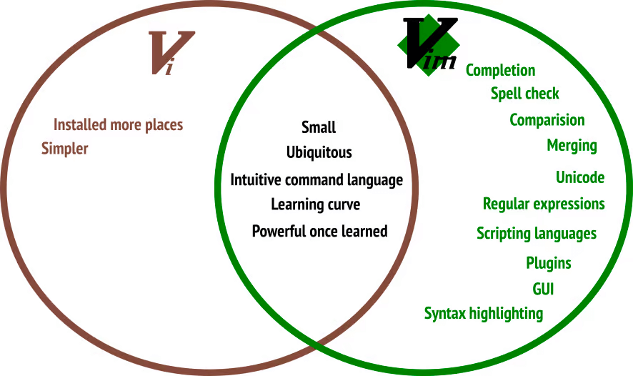

Slide 6


Slide 7


Slide 8
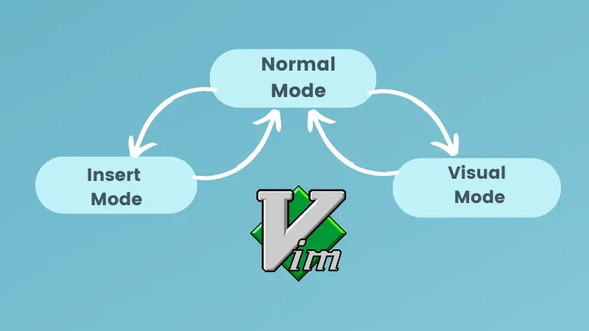

Slide 9
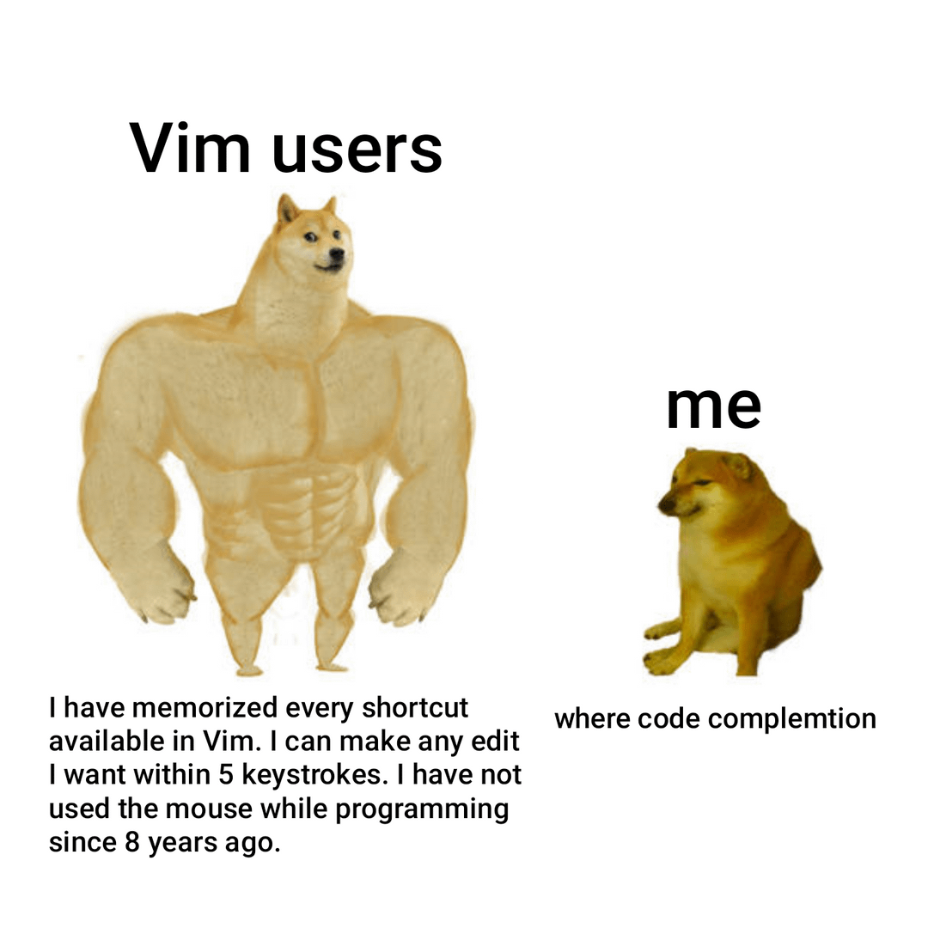

Slide 10
Getting start with a .vimrc
A vimrc file is a configuration file for the Vim text editor. The name “vimrc” stands for “Vim run commands.” This file contains settings and commands that Vim executes every time it starts.

Slide 11
Vim for Norminette
Those settings can be useful for norminette

Slide 12
Vim autocomplete

